Slide 1
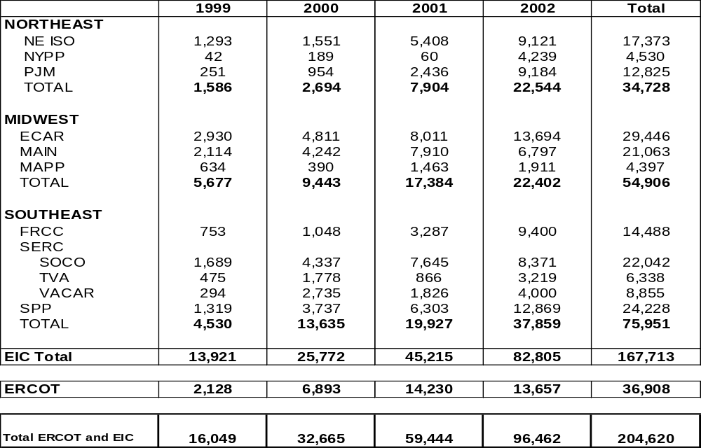
New Generation
April 25, 2001

